Slide 1
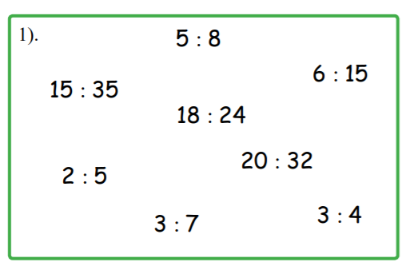
Activity – find the equivalent ratios

Slide 2
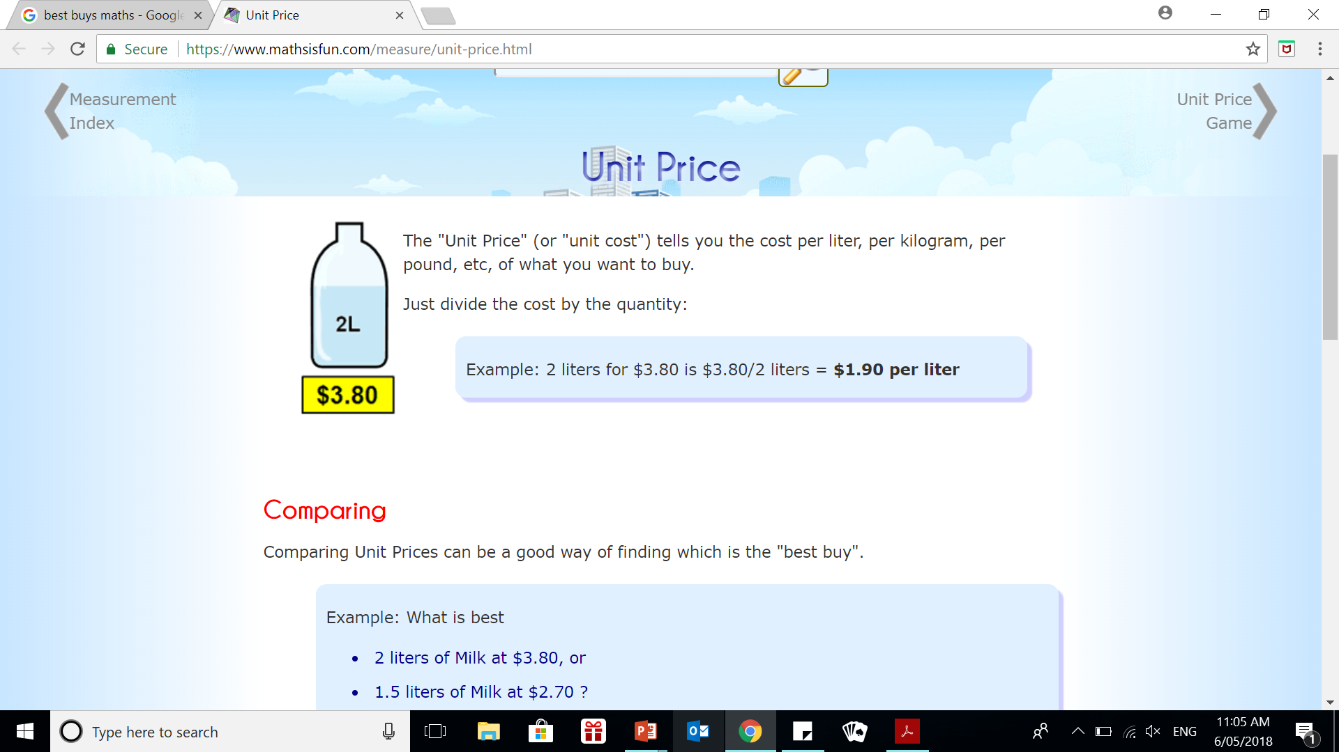
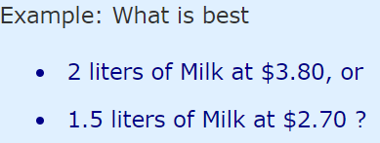

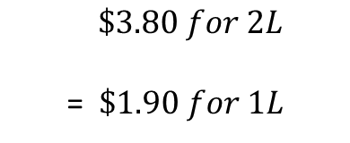



24
7
30
Date
Rates
EQ – how do I find the best buy?
What is a unit price
$\$3.80 for 2L$
= $\$1.90 for 1L$
Comparing Unit Price
Comparing Unit Prices can be a good way of finding which is the "best buy"
Best Buy
$$\$3.80 ÷ 2L$$
$$\$2.70 ÷1.5L$$
$$=\$1.90 per Litre$$
$$=\$1.80 per Litre$$

Slide 3
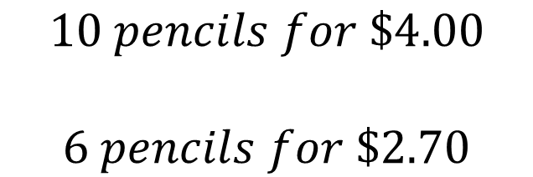
PRACTICE - TOGETHER
Best Buy ?
$$10 pencils for \$4.00$$
$$6 pencils for \$2.70$$

Slide 4
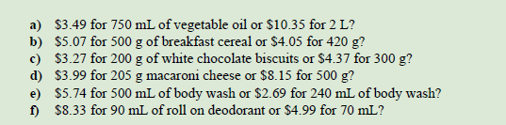
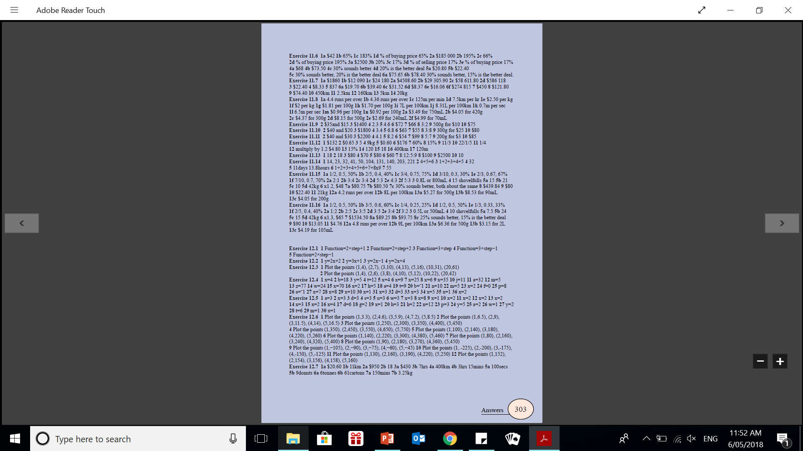
Your turn

